Slide 1
Module 10: Network Services
Instructor Materials
CyberOps Associate v1.0
Notes:
Cisco Networking Academy Program
CyberOps Associate v1.0
Module 10: Network Services

Slide 2
Instructor Materials – Module 10 Planning Guide
This PowerPoint deck is divided in two parts:
Instructor Planning Guide
Information to help you become familiar with the module
Teaching aids
Instructor Class Presentation
Optional slides that you can use in the classroom
Begins on slide # 9
Note: Please remove the Planning Guide from this presentation before sharing with anyone.
For additional help and resources, go to the Instructor Home Page and Course Resources for this course. You also can visit the professional development site on www.netacad.com, the official Cisco Networking Academy Facebook page, or Instructor Only FB group.
Notes:
2

Slide 3
What to Expect in this Module
To facilitate learning, the following features within the GUI may be included in this module:
Feature | Description
Animations | Expose learners to new skills and concepts.
Check Your Understanding(CYU) | Per topic online quiz to help learners gauge content understanding.
Hands-On Labs | Labs designed for working with physical equipment.
Module Quizzes | Self-assessments that integrate concepts and skills learned throughout the series of topics presented in the module.
Module Summary | Briefly recaps module content.

Slide 4
Check Your Understanding
Check Your Understanding activities are designed to let students quickly determine if they understand the content and can proceed, or if they need to review.
Check Your Understanding activities do not affect student grades.
There are no separate slides for these activities in the PPT. They are listed in the notes area of the slide that appears before these activities.
Notes:
4

Slide 5
Module 10: Activities
What activities are associated with this module?
Page # | Activity Type | Activity Name | Optional?
10.1.4 | Check Your Understanding | DHCP | Recommended
10.2.7 | Lab | Using Wireshark to Examine a UDP DNS Capture | Recommended
10.3.3 | Animation | How NAT Works? | Recommended
10.3.4 | Animation | Port Address Translation
10.4.3 | Lab | Using Wireshark to Examine TCP and UDP Captures | Recommended
10.6.7 | Lab | Using Wireshark to Examine HTTP and HTTPS Traffic | Recommended
Notes:
5

Slide 6
Module 10: Best Practices
Prior to teaching Module 10, the instructor should:
Review the activities and assessments for this module.
Try to include as many questions as possible to keep students engaged during classroom presentation.
Topic 10.1
Differentiate between static addressing and dynamic addressing in DHCP.
Explain the terms pool and lease period.
Discuss various DHCP operations.
List the fields of DHCP message format.
Notes:
6

Slide 7
Module 10: Best Practices (Cont.)
Topic 10.2
Introduce DNS and discuss the levels in DNS domain hierarchy.
Discuss the steps involved in DNS resolution.
State the difference between DNS and DDNS.
Discuss the various terms in WHOIS protocol.
Topic 10.3
Discuss how NAT is used to translate private address into public address.
Play an animation to view the PAT process.
Notes:
7

Slide 8
Module 10: Best Practices (Cont.)
Topic 10.4
Demonstrate a SMB diagram with its key terms and icons.
Differentiate between FTP and TFTP.
Topic 10.5
Ask the learners how often do they write emails on a daily basis? Have they ever wondered what happens at the back end when an email is sent or when an email is received in an inbox?
Explain SMTP, POP and IMAP with examples.
Notes:
8

Slide 9
Module 10: Best Practices (Cont.)
Topic 10.6
Ask the class what is a URL and what protocol is used in a URL?
Explain how a web page is opened in a browser.
Ask the class if they are familiar with HTTP status codes or have come across any.
Explain all status codes with their examples.
Notes:
9

Slide 10
Module 10: Network Services
CyberOps Associate v1.0
Notes:
Cisco Networking Academy Program
CyberOps Associate v1.0
Module 10: Network Services
In-Session Activities / Explanations:
Time: 5 min
Instructor Notes:
Welcome the audience in a warm and cordial manner. Ensure that everyone is set up with the required resources.
Introduce the topic and encourage learners to come up with a list of expectations from the session. Collate topics on the white board or Desktop while using learner’s inputs to interpret them in words.
Read out the Objectives and briefly describe each.
Key Points: NA

Slide 11
Module Objectives
Module Title: Network Services
Module Objective: Explain how network services enable network functionality.
Topic Title | Topic Objective
DHCP | Explain how DHCP services enable network functionality.
DNS | Explain how DNS services enable network functionality.
NAT | Explain how NAT services enable network functionality.
File Transfer and Sharing Services | Explain how file transfer services enable network functionality.
Email | Explain how email services enable network functionality.
HTTP | Explain how HTTP services enable network functionality.
Notes:
11
10 – Network Services
10.0 – Introduction
10.0.2 – What Will I Learn in this Module?

Slide 12
10.1 DHCP
Notes:
Source:
10 – Network Services
10.1– DHCP
In-Session Activities / Explanations:
Time: 12 min
Instructor Notes:
Introduce the topic and explain the importance of DHCP.
Discuss DHCP operations.
Explain DHCP message format.
Encourage the students to complete the ‘Check Your Understanding – DHCP’ in section 10.1.4.
Key Points: DHCP, static addressing ,dynamic addressing, DHCP operations. Structure of DHCP message.

Slide 13
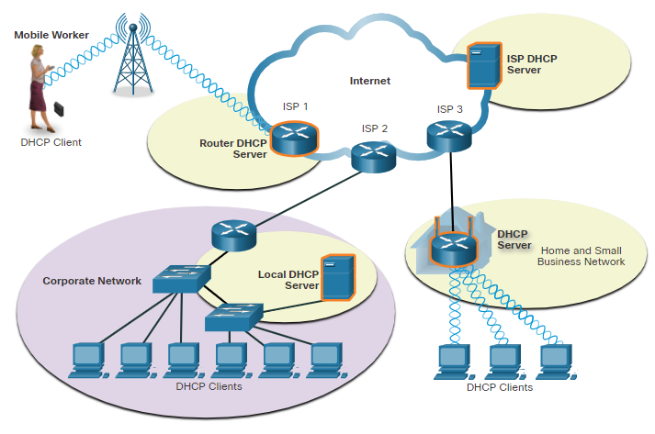
Network Services
Dynamic Host Configuration Protocol
Two types of addressing:
Dynamic – Dynamic Host Configuration Protocol (DHCP) for IPv4 service automates the assignment of IPv4 addresses, subnet masks, gateways, and other IPv4 networking parameters.
Static – The network administrator manually enters IP address information on hosts.
When a host connects to the network, the DHCP server chooses an address from a configured range of addresses called a pool and assigns it to the host.
DHCP can allocate IP addresses for a configurable period of time, called a lease period.
Medium-to-large networks – DHCP server is a local PC-based server
Home network – DHCP server is on the local router connecting the home network to the ISP.
Notes:
10– Network Services
10.1 – DHCP
10.1.1 – Dynamic Host Configuration Protocol

Slide 14
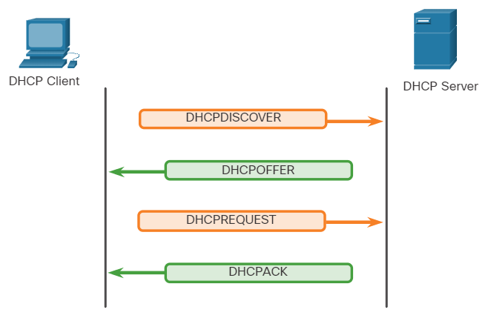
Network Services
DHCP Operation
DHCP operation includes: DHCPDISCOVER, DHCPOFFER, DHCPREQUEST, DHCPACK, and DHCPNAK.
When DHCP-configured device connects to the network, the client broadcasts a DHCPDISCOVER message to identify any available DHCP servers on the network.
A DHCP server replies with a DHCPOFFER message, which offers a lease to the client.
The client sends a DHCPREQUEST message that identifies the explicit server and lease offer that the client is accepting.
If the IPv4 address requested by the client, or offered by the server, is still available, the server returns the DHCPACK message. If the offer is no longer valid, then the selected server responds with a DHCPNAK message. If a DHCPNAK message is returned, then the selection process begins again with a new DHCPDISCOVER message being transmitted.
Notes:
10– Network Services
10.1 – DHCP
10.1.2 – DHCP Operation

Slide 15
Network Services
DHCP Message Format
The DHCPv4 message format is used for all DHCPv4 transactions.
The DHCPv4 messages are encapsulated within the UDP transport protocol.
The below table lists the fields covered in the structure of the DHCPv4 message.
Fields in the structure of DHCPv4 Message
Operation (OP) Code | Seconds | Gateway IP Address
Hardware Type | Flags | Client Hardware Address .
Hardware Address Length | Client IP Address | Server Name
Hops | Your IP Address | Boot Filename
Transaction Identifier | Server IP Address | DHCP Options
Notes:
10 – Network Services
10.1 – DHCP
10.1.3 – DHCP Message Format
10.1.4 – Check Your Understanding - DHCP

Slide 16
10.2 DNS
Notes:
Source:
10 – Network Services
10.2 – DNS
In-Session Activities / Explanations:
Time: 7 min
Instructor Notes:
Provide an overview of DNS.
Illustrate the levels of the DNS domain hierarchy on the white board and explain the concept.
Describe the DNS Look UP process
Discuss dynamic DNS with an example.
Walk the leaners through the structure of the DNS message format
At the end of the topic, enquire how the learners performed during the lab.
Key Points: DHCP, static addressing, dynamic addressing, DHCP operations, Structure of DHCP message, Levels of DNS domain.

Slide 17
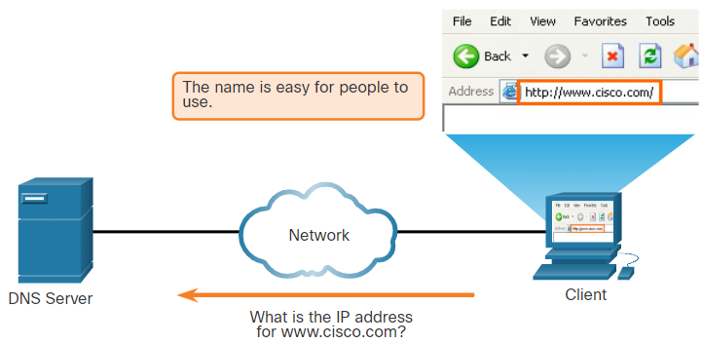
DNS
DNS Overview
Domain Name System (DNS) provides domain names and their associated IP addresses.
The DNS system consists of a global hierarchy of distributed servers that contain databases of name to IP address mappings.
The client computer in the figure will send a request to the DNS server to get the IP address for www.cisco.com so that it can address packets to that server.
Malicious DNS traffic can be detected through protocol analysis and the inspection of DNS monitoring information.
DNS Resolves Names to IP Addresses
Notes:
10– Network Services
10.2 – DNS
10.2.1- DNS Overview

Slide 18
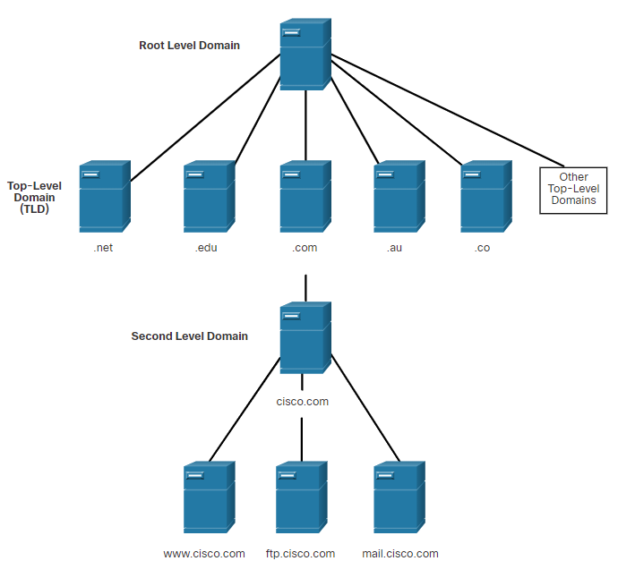
DNS
The DNS Domain Hierarchy
DNS consists of a hierarchy of generic top-level domains and numerous country-level domains.
The second-level domains are represented by a domain name that is followed by a top-level domain.
Subdomains are found at the next level of the DNS hierarchy and represent some division of the second-level domain.
Fourth level domain can represent a host in a subdomain.
Top-level domains represent either the type of organization or country of origin. Examples: (.org) - a non-profit organization, (.au) – Australia.
DNS Hierarchy
Notes:
10– Network Services
10.2 – DNS
10.2.2- The DNS Domain Hierarchy

Slide 19
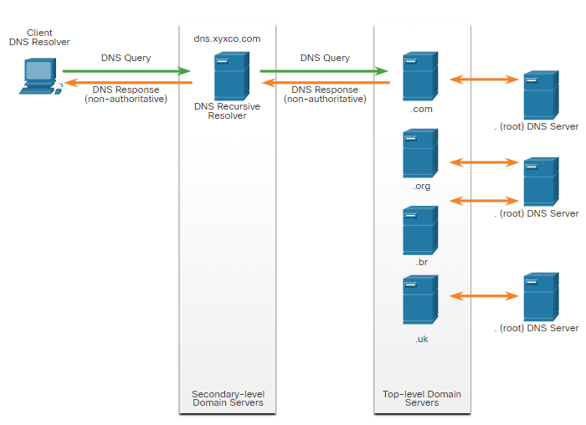
DNS
The DNS Lookup Process
To resolve a name to an IP address, the resolver, will first check its local DNS cache. If the mapping is not found, a query will be issued to the DNS server .
If the mapping is not found there, the DNS server will query other higher-level DNS servers that are authoritative for the top-level domain in order to find the mapping. These are known as recursive queries.
The caching DNS servers can resolve recursive queries without forwarding the queries to higher level servers.
If a server requires data for a zone, it will request a transfer of that data from an authoritative server for that zone. The process of transferring DNS data between servers is known as zone transfer.
Notes:
10– Network Services
10.2 – DNS
10.2.3 - The DNS Lookup Process

Slide 20
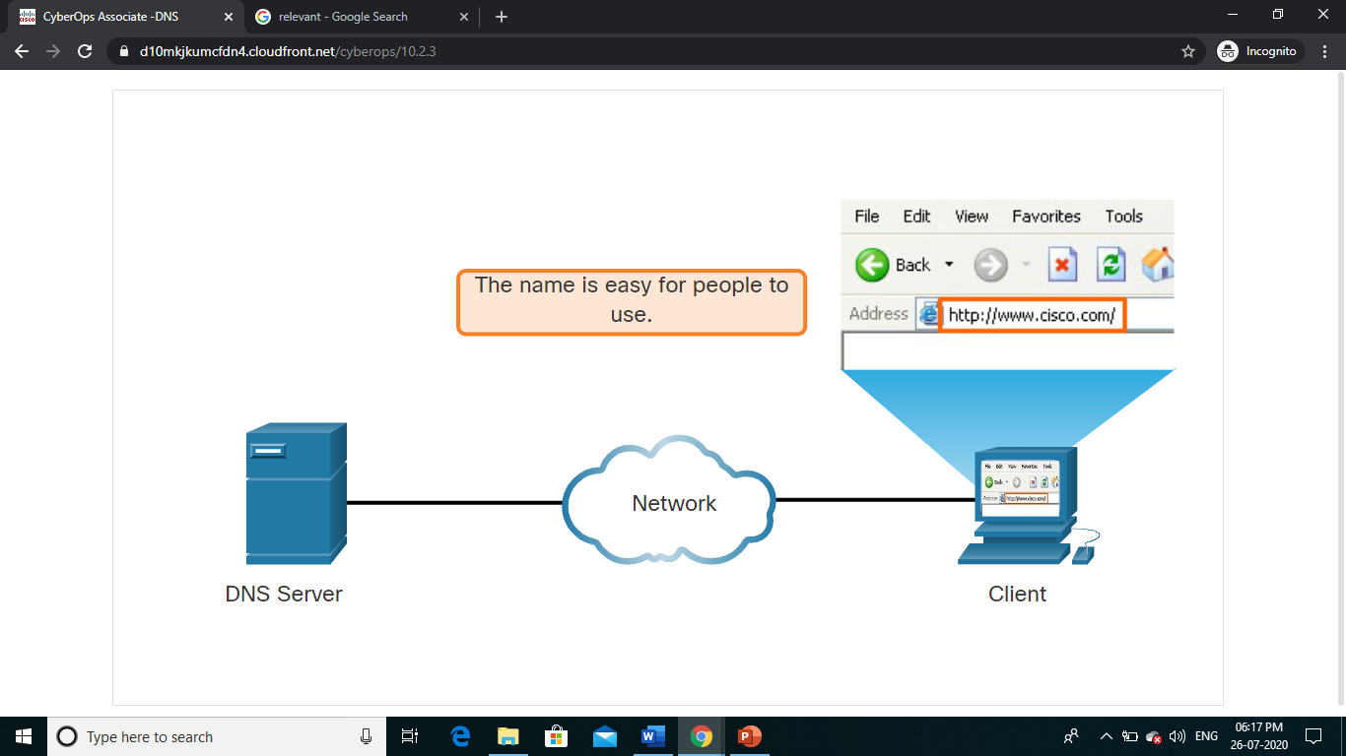
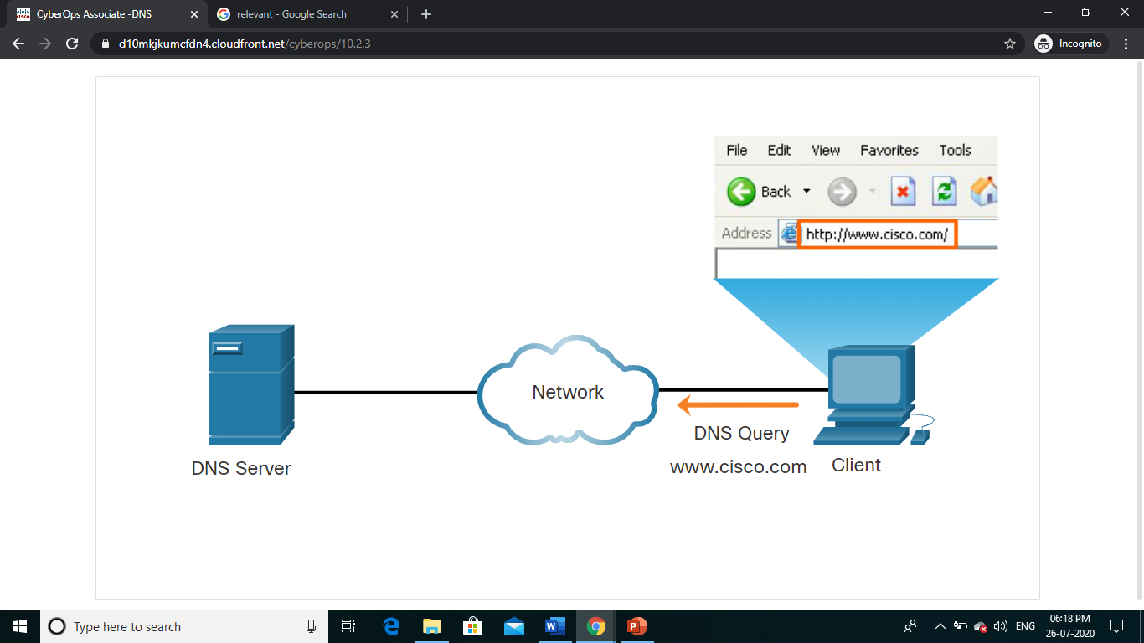
DNS
The DNS Lookup Process(Contd.)
Steps involved in DNS resolution:
Step 1 - The user types an FQDN into a browser application Address field.
Step 2 - A DNS query is sent to the designated DNS server for the client computer.
Notes:
10– Network Services
10.2 – DNS
10.2.3 - The DNS Lookup Process

Slide 21
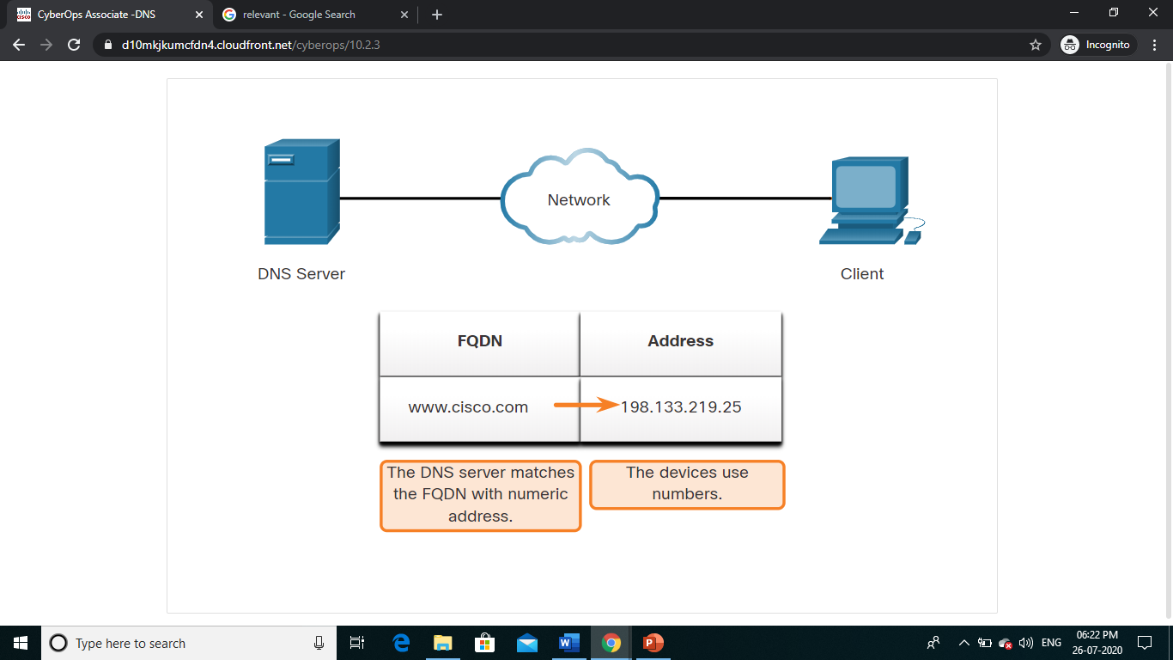
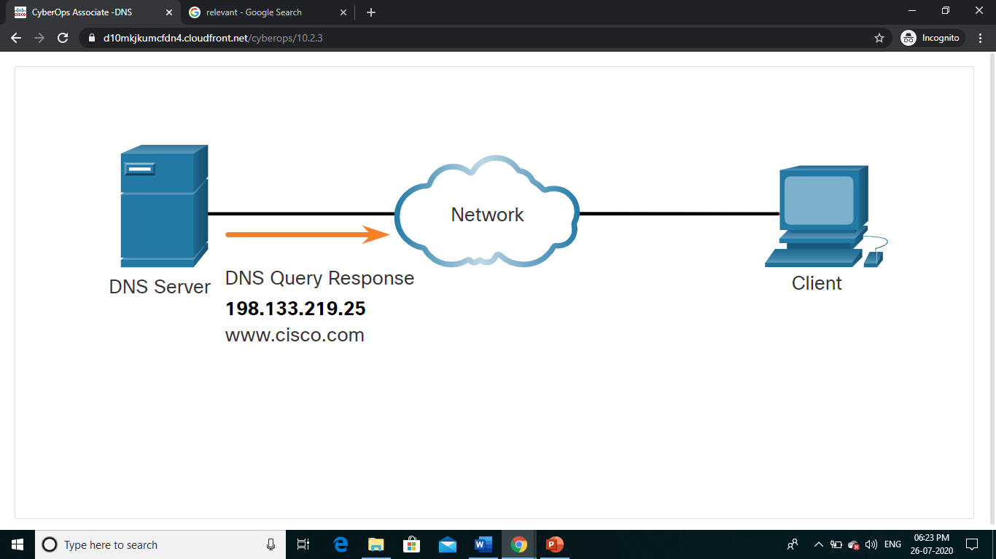
DNS
The DNS Lookup Process(Contd.)
Steps involved in DNS resolution:
Step 3 - The DNS server matches the FQDN with its IP address.
Step 4 - The DNS query response is sent back to the client with the IP address for the FQDN.
Notes:
10– Network Services
10.2 – DNS
10.2.3 - The DNS Lookup Process

Slide 22
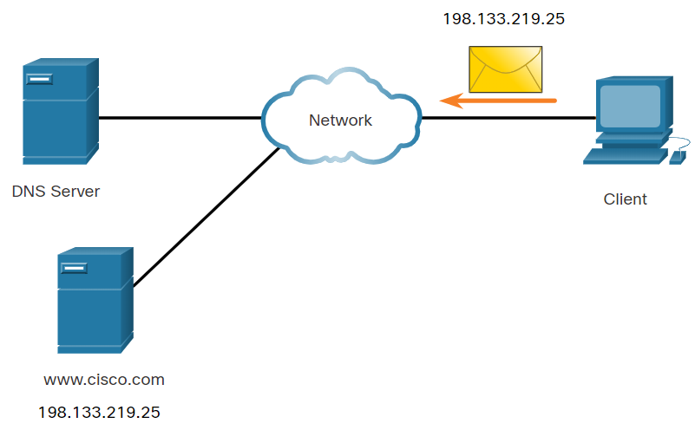
DNS
The DNS Lookup Process(Contd.)
Steps involved in DNS resolution:
Step 5 - The DNS server matches the FQDN with its IP address.
Notes:
10– Network Services
10.2 – DNS
10.2.3 - The DNS Lookup Process

Slide 23
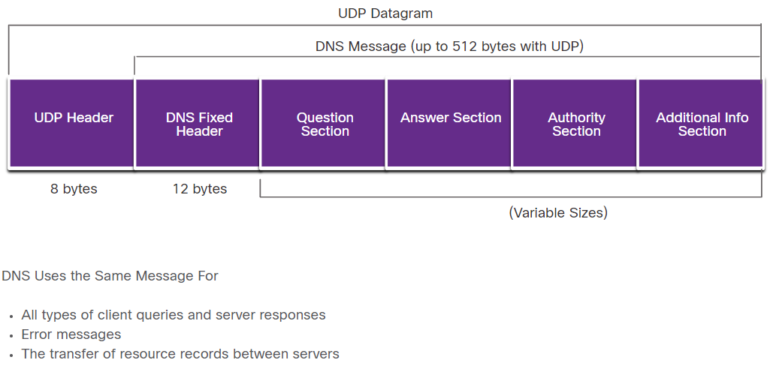
DNS
DNS Message Format
DNS uses UDP port 53 for DNS queries and responses.
If a DNS response exceeds 512 bytes, Dynamic DNS (DDNS) is used.
The DNS protocol communications use a single format called a message.
DNS uses the same message format for all types of client queries and server responses, error messages, and transfer of resource record information.
Notes:
10– Network Services
10.2 – DNS
10.2.4 - DNS Message Format

Slide 24
DNS
DNS Message Format (Contd.)
Sections of DNS message format :
DNS message section | Description
Question | The question for the server. It contains the domain name to be resolved, the class of domain, and the query type.
Answer | The DNS resource record, or RR, for the query including the resolved IP address depending on the RR type.
Authority | Contains the RRs for the domain authority.
Additional | Relevant to query responses only. Consists of RRs that hold additional information that will make query resolution more efficient
Notes:
10– Network Services
10.2 – DNS
10.2.4 - DNS Message Format

Slide 25
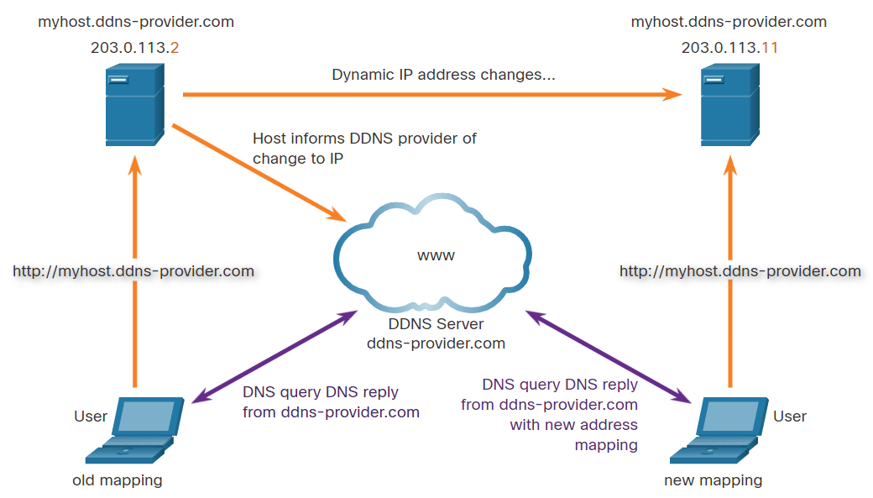
DNS
Dynamic DNS
Dynamic DNS (DDNS) allows a user or organization to register an IP address with a domain name as in DNS.
The subdomain is mapped to the IP address of the user’s server, or home router connection to the internet.
When a change is detected, the DDNS provider is immediately informed of the change and the mapping between the user’s subdomain and the internet IP address is immediately updated.
The DDNS provider service supplies that IP address to the resolver’s second level DNS server. This DNS server, either at the organization or ISP, provides the DDNS IP address to the resolver.
Notes:
10– Network Services
10.2 – DNS
10.2.5- Dynamic DNS

Slide 26
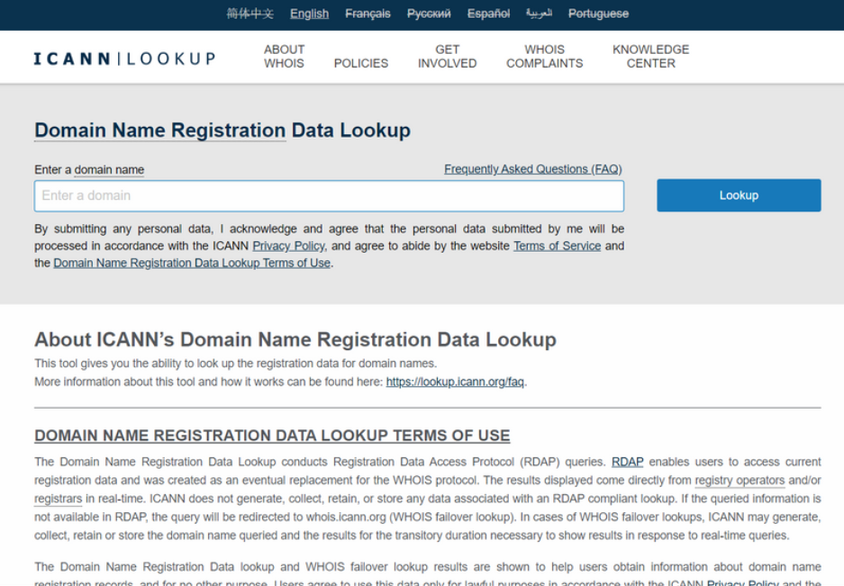
DNS
The WHOIS Protocol
WHOIS is a TCP-based protocol that is used to identify the owners of internet domains through the DNS system.
The WHOIS application uses a query, in the form of a FQDN.
WHOIS is a starting point for identifying potentially dangerous internet locations that may have been reached through the network.
ICANN Lookup, an internet-based WHOIS tool, is used to obtain the registration record a URL.
Notes:
10– Network Services
10.2 – DNS
10.2.6- The WHOIS Protocol

Slide 27
DNS
Lab - Using Wireshark to Examine a UDP DNS Capture
In this lab, you will complete the following objectives:
Communicate with a DNS server by sending a DNS query using the UDP transport protocol.
Use Wireshark to examine the DNS query and response exchanges with the same server.
Notes:
10– Network Services
10.2 – DNS
10.2.7 - Lab - Using Wireshark to Examine a UDP DNS Capture

Slide 28
10.3 NAT
Notes:
Source:
10 – Network Services
10.3 - NAT
In-Session Activities / Explanations:
Time: 5 min
Instructor Notes:
Provide an overview of NAT.
Explain the how NAT works via an animation
Describe the PAT process
Key Points: ipv4 address space, NAT, PAT

Slide 29
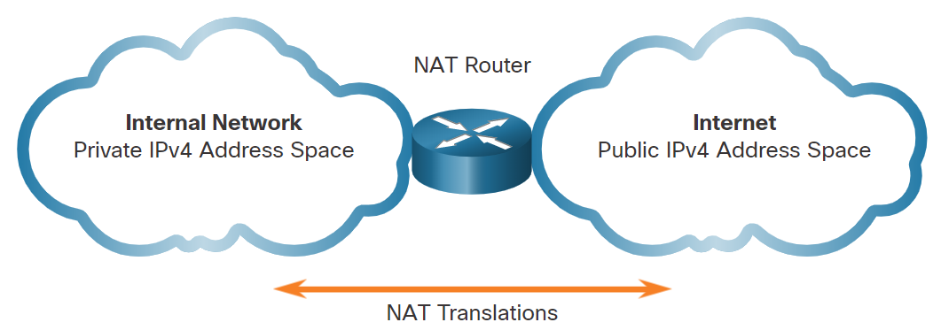
NAT
IPv4 Private Address Space
To allow a device with a private IPv4 address to access devices and resources outside the local network, the private address must be translated to a public address.
NAT provides the translation of private addresses to public addresses.
A single, public IPv4 address can be shared by thousands of devices, each configured with a unique private IPv4 address.
The solution to the exhaustion of IPv4 address space and the limitations of NAT is the eventual transition to IPv6.
Notes:
10– Network Services
10.3– NAT
10.3.1 - IPv4 Private Address Space

Slide 30
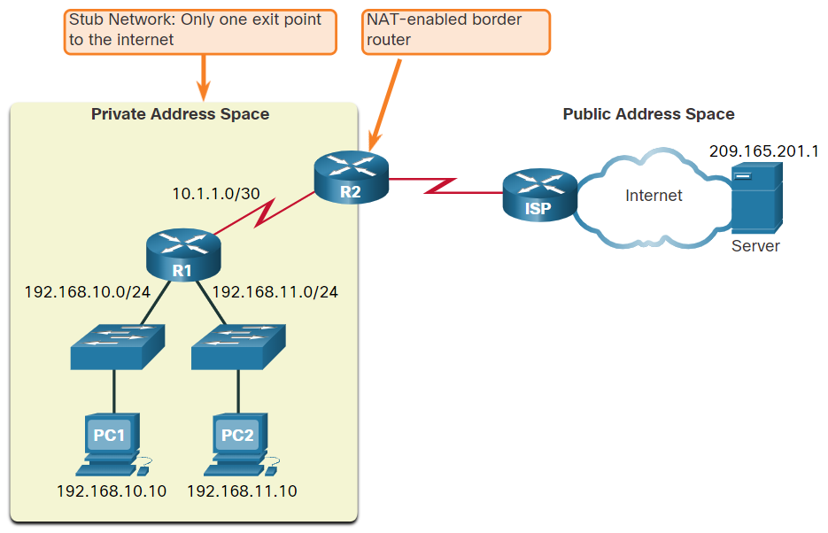
NAT
What is NAT?
NAT is used to conserve public IPv4 addresses.
NAT-enabled routers can be configured with one or more valid public IPv4 addresses which are known as the NAT pool.
A NAT router typically operates at the border of a stub network.
When a device inside the stub network wants to communicate with a device outside its network, the packet is forwarded to the border router and the router performs the NAT process.
Note: The connection to the ISP may use a private address or a public address that is shared among customers. For the purposes of this module, a public address is shown.
Notes:
10– Network Services
10.3– NAT
10.3.2 - What is NAT?

Slide 31
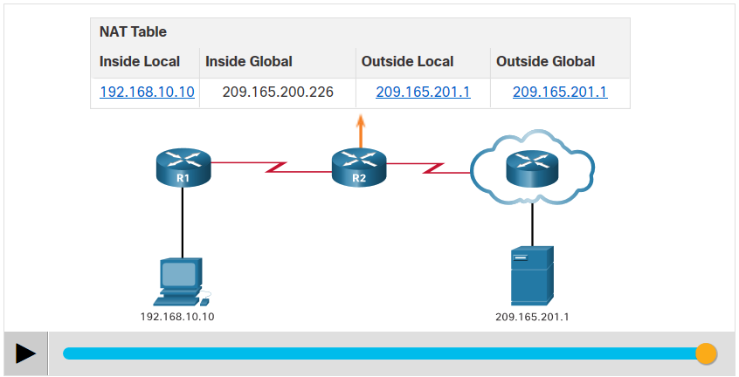
NAT
How NAT works?
In this example, PC1 with private address 192.168.10.10 wants to communicate with an outside web server with public address 209.165.201.1.
Click the Play button in the figure to view the animation.
Notes:
10– Network Services
10.3– NAT
10.3.3 - How NAT works?

Slide 32
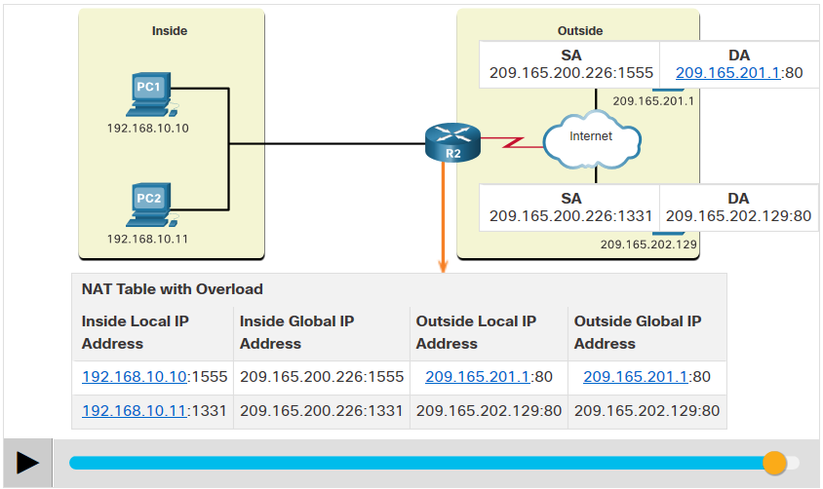
NAT
Port Address Translation
Port Address Translation (PAT), also known as NAT overload, maps multiple private IPv4 addresses to a single public IPv4 address or a few addresses.
When a device initiates a TCP/IP session, it generates a TCP or UDP source port value, or a specially assigned query ID for ICMP, to uniquely identify the session.
PAT ensures that devices use a different TCP port number for each session with a server on the internet.
PAT adds unique source port numbers to the inside global address to distinguish between translations.
Click Play in the figure to view an animation of the PAT process.
Notes:
10– Network Services
10.3– NAT
10.3.4 - Port Address Translation

Slide 33
10.4 File Transfer and Sharing Services
Notes:
Source:
10 – Network Services
10.4 - File Transfer and Sharing Services
In-Session Activities / Explanations:
Time: 18 mins
Instructor Notes:
Introduce the topics FTP and TFTP
Explain SMB.
At the end of the topic, enquire how the learners have performed during the lab session.
Key Points: FTP and TFTP and SMB.

Slide 34
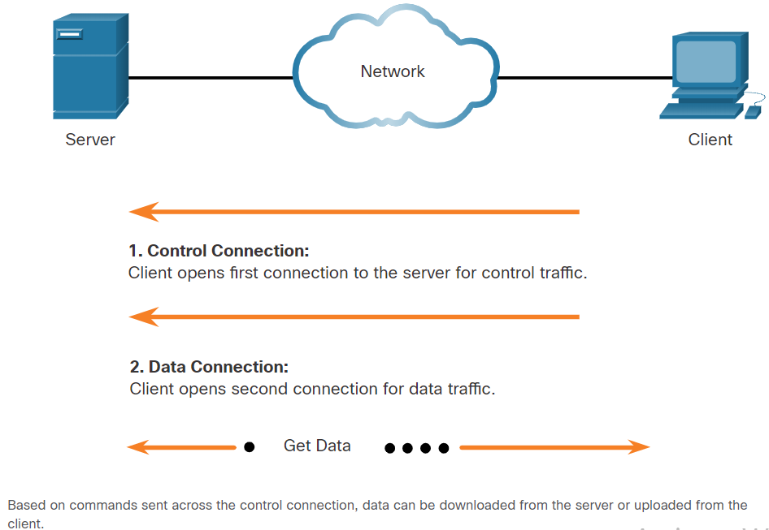
File Transfer and Sharing Services
FTP and TFTP
FTP allows data transfers between a client and a server.
An FTP client runs on a computer and is used to push and pull data from an FTP server.
FTP connections between the client and server:
Control Connection: The client opens the first connection to the server for control traffic.
Data Connection: The client opens the second connection to the server for data traffic.
Trivial File Transfer Protocol (TFTP) is a simplified file transfer protocol that uses well-known UDP port number 69.
Notes:
10 – Network Services
10.4 – File Transfer and Sharing Services
10.4.1 - FTP and TFTP

Slide 35
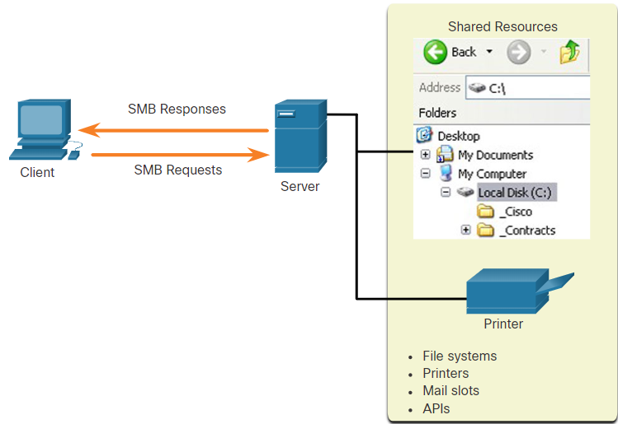
File Transfer and Sharing Services
SMB
The Server Message Block (SMB) is a client/server file sharing protocol that describes the structure of shared network resources.
SMB is a client/server, request-response protocol.
Servers can make their own resources available to clients on the network.
Notes:
10 – Network Services
10.4 – File Transfer and Sharing Services
10.4.2 - SMB

Slide 36
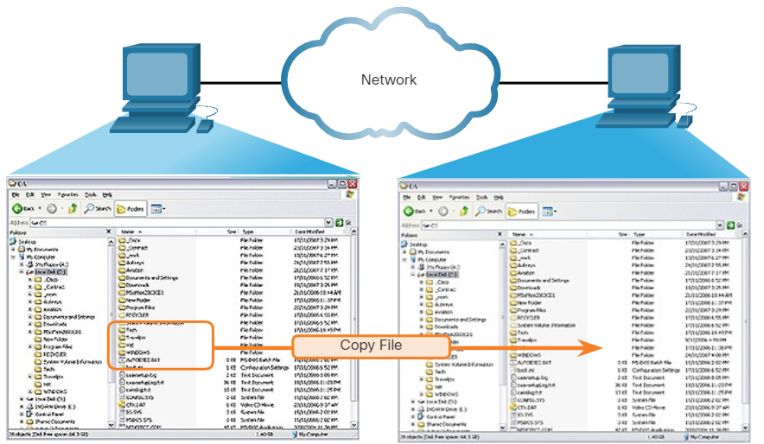
File Transfer and Sharing Services
SMB (Contd.)
SMB messages can start, authenticate, and terminate sessions, control file and printer access, and allow an application to send or receive messages to or from another device.
SMB file sharing and print services have become the mainstay of Microsoft networking.
A file may be copied from PC to PC with Windows Explorer using the SMB protocol.
Notes:
10 – Network Services
10.4 – File Transfer and Sharing Services
10.4.2 - SMB

Slide 37
File Transfer and Sharing Services
Lab - Using Wireshark to Examine TCP and UDP Captures
In this lab, you will complete the following objectives:
Identify TCP Header Fields and Operation Using a Wireshark FTP Session Capture
Identify UDP Header Fields and Operation Using a Wireshark TFTP Session Capture
Notes:
10 – Network Services
10.4 – File Transfer and Sharing Services
10.4.3 - Lab - Using Wireshark to Examine TCP and UDP Captures

Slide 38
10.5 Email
Notes:
Source:
10 – Network Services
10.5 - Email
In-Session Activities / Explanations:
Time: 5 min
Instructor Notes:
Explain Email protocol.
Discuss SMTP, POP and IMAP.
Key Points: SMTP, POP and IMAP

Slide 39
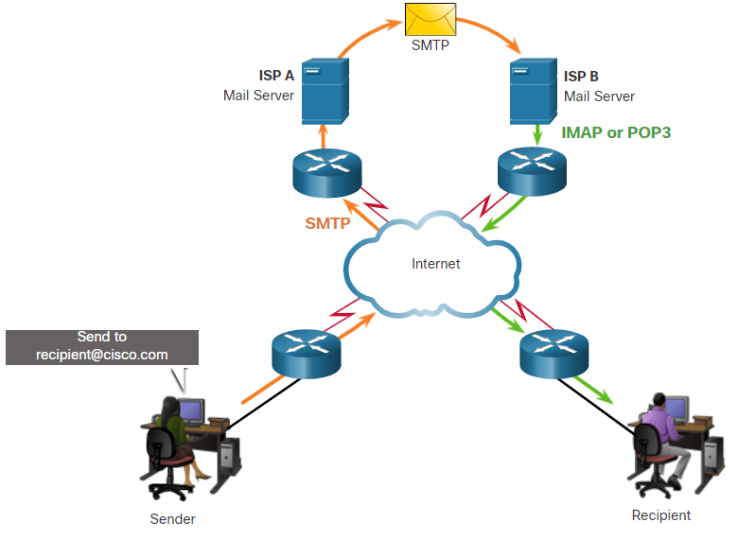
Email
Email protocols
Email is a store-and-forward method of sending, storing, and retrieving electronic messages across a network.
Email clients communicate with mail servers to send and receive email.
Email supports three separate protocols for operation: Simple Mail Transfer Protocol (SMTP), Post Office Protocol (POP), and IMAP.
A client retrieves email using one of the two application layer protocols: POP or IMAP.
Notes:
10– Network Services
10.5 - Email
10.5.1 – Email protocols.

Slide 40
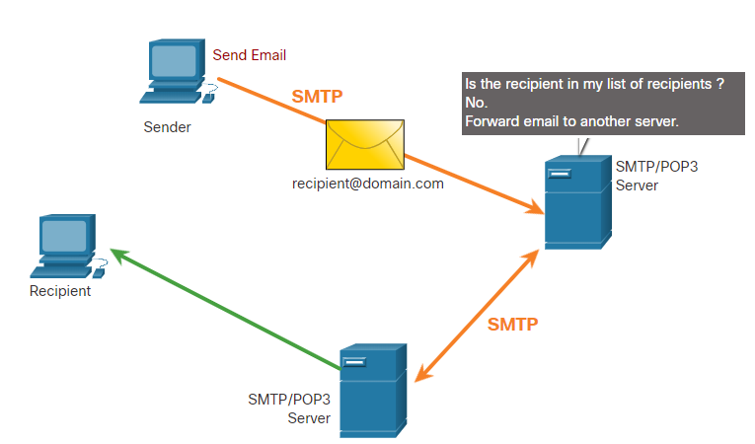
Email
SMTP
SMTP message formats require a message header and a message body.
When a client sends an email, the client SMTP process connects with a server SMTP process on a well-known port 25.
When the server receives the message, it either places the message in a local account, if the recipient is local, or forwards the message to another mail server for delivery.
Periodically, the server checks the queue for messages and attempts to send them again. If the message is still not delivered after a predetermined expiration time, it is returned to the sender as undeliverable.
Notes:
10– Network Services
10.5 - Email
10.5.2 – SMTP

Slide 41
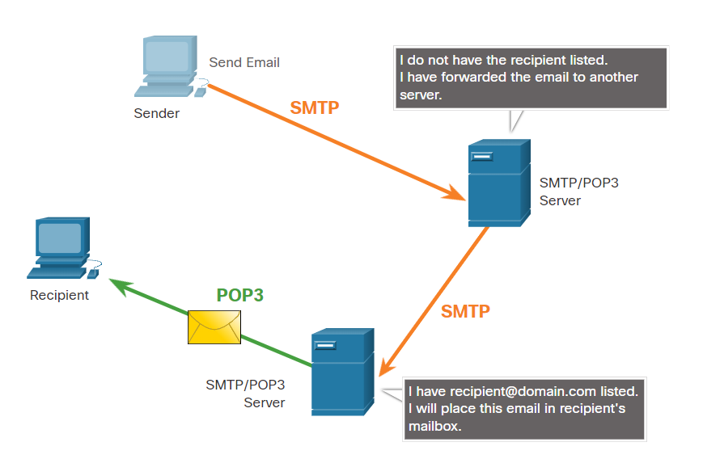
Email
POP3
POP3 is used by an application to retrieve a mail from a mail server.
With POP3, email messages are downloaded to the client and removed from the server.
The server starts the POP3 service by passively listening on TCP port 110 for client connection requests.
The client sends a request to establish a TCP connection with the server.
Once the connection is established, the POP3 server sends a greeting. The client and POP3 server then exchange commands and responses until the connection is closed or aborted.
Notes:
10– Network Services
10.5 - Email
10.5.3 – POP3

Slide 42
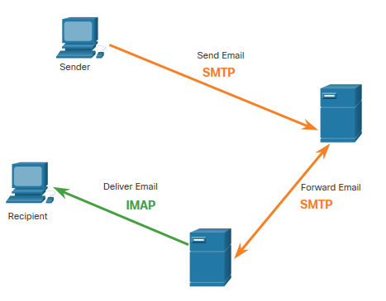
Email
IMAP
IMAP is the protocol that describes a method to retrieve email messages.
When the user connects to an IMAP-capable server, copies of the messages are downloaded to the client application. The original messages are kept on the server until manually deleted.
Users view copies of the messages in their email client software.
Users can create a file hierarchy on the server to organize and store mail.
When a user decides to delete a message, the server synchronizes that action and deletes the message from the server.
Notes:
10– Network Services
10.5 - Email
10.5.4 – IMAP

Slide 43
10.6 HTTP
Notes:
Source:
10 – Network Services
10.6 - HTTP
In-Session Activities / Explanations:
Time: 8 min
Instructor Notes:
Discuss the HTTP protocol along with its methods.
Define the HTTP status codes.
Differentiate between HTTP and HTTP/2.
Reinforce the difference between HTTP and HTTPS.
Key Points: HTTP and HTTP URL, HTTP operations, HTTP status codes, HTTP/2

Slide 44
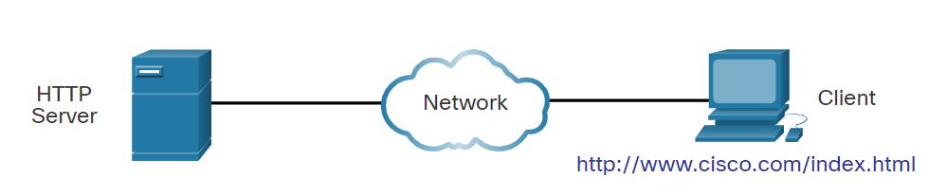
HTTP
Hypertext Transfer Protocol and Hypertext Markup Language
When a web address or Uniform Resource Locator (URL) is typed into a web browser, the web browser establishes a connection with the web service that is using the HTTP protocol.
Lets take a look on how a web page is opened in a browser. Example: http://www.cisco.com/index.html
Step 1: The browser interprets the three parts of the URL:
http (the protocol or scheme)
www.cisco.com (the server name)
index.html (the specific filename requested)
Notes:
10– Network Services
10.6 - HTTP
10.6.1 – Hypertext Transfer Protocol and Hypertext Markup Language

Slide 45
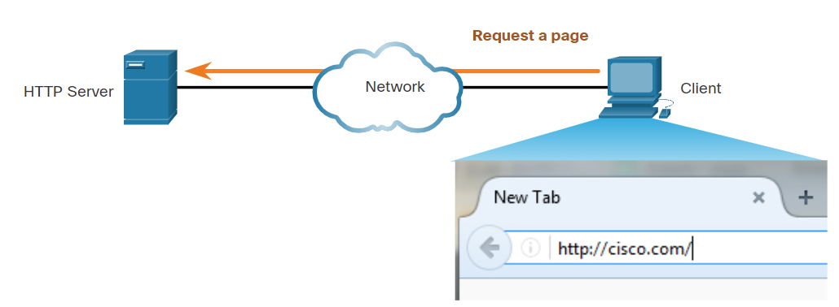
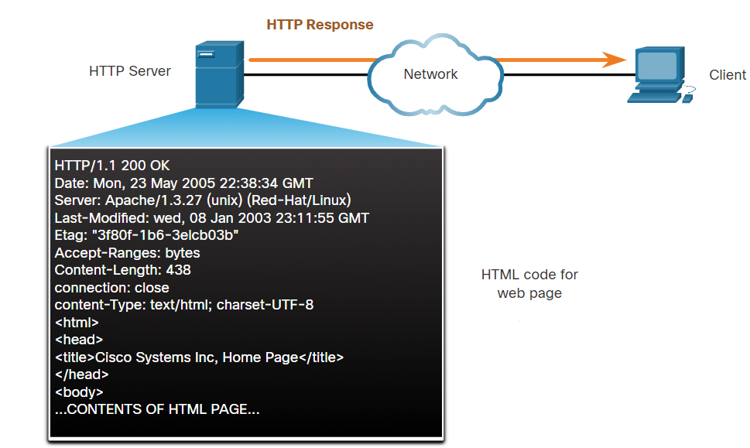
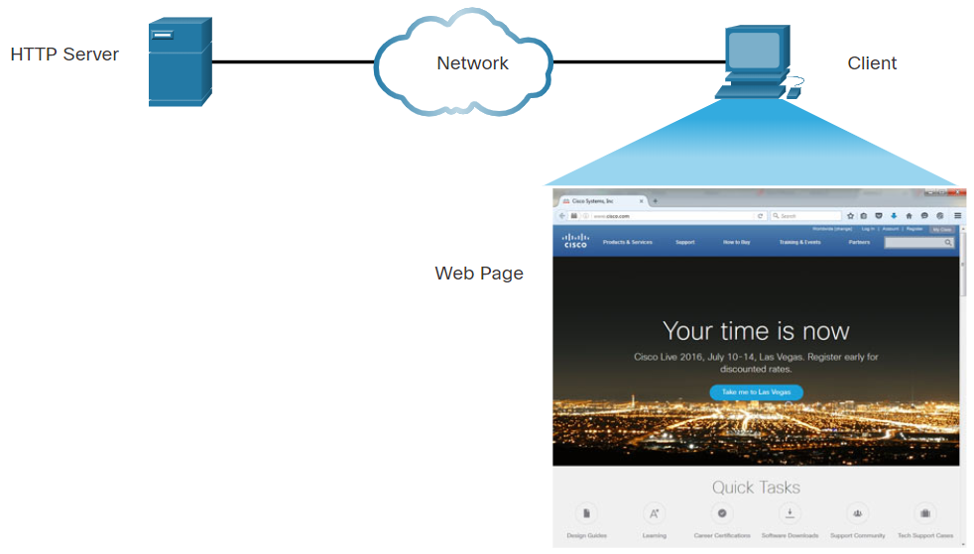
HTTP
Hypertext Transfer Protocol and Hypertext Markup Language (Contd.)
Step 2: The client initiates an HTTP request to a server by sending a GET request to the server and asks for the index.html file.
Step 3: In response to the request, the server sends the HTML code for this web page to the browser.
Step 4: The browser deciphers the HTML code and formats the page for the browser window.
Notes:
10– Network Services
10.6 - HTTP
10.6.1 – Hypertext Transfer Protocol and Hypertext Markup Language

Slide 46
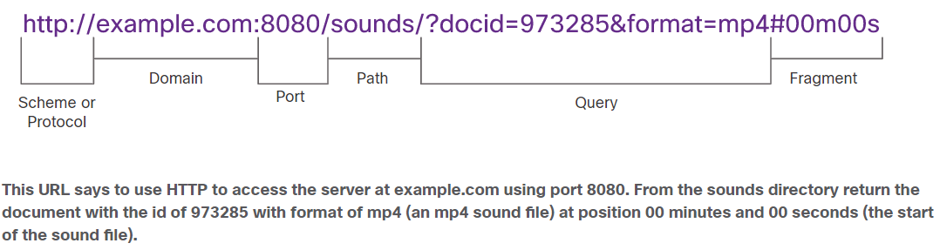
HTTP
The HTTP URL
HTTP URLs can specify the port on the server that should handle the HTTP methods.
It can specify a query string and fragment.
Query strings are preceded by a “?” character and typically consist of a series of name and value pairs.
A fragment is preceded by a “#” character. It refers to a subordinate part of the resource that is requested in the URL.
The parts of an HTTP URL are shown in the below figure:
Notes:
10– Network Services
10.6 - HTTP
10.6.2 – The HTTP URL

Slide 47
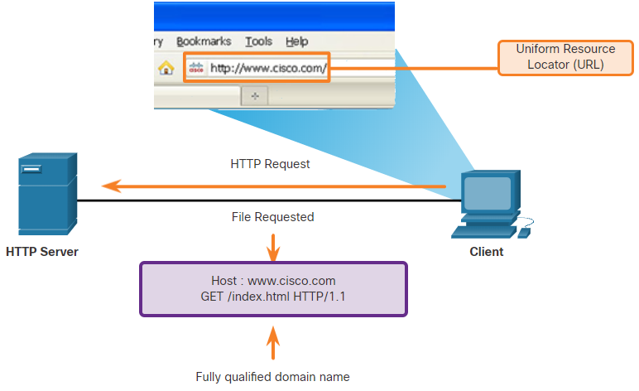
HTTP
HTTP Operation
HTTP is a request/response protocol that uses TCP port 80.It is flexible but not a secure protocol.
When a client sends a request to a web server, it will use one of the six methods specified by HTTP:
GET
POST
PUT
DELETE
OPTIONS
CONNECT
Notes:
10– Network Services
10.6 - HTTP
10.6.3 – HTTP Operation

Slide 48
HTTP
HTTP Status Codes
The HTTP Status codes are numeric, with the first number in the code indicating the type of message.
The five status code groups are 1xx - Informational, 2xx - Success, 3xx - Redirection , 4xx - Client Error and 5xx - Server Error
The below table explains some common status codes:
Code | Status | Meaning
1xx - Informational
100 | Continue | The client should continue with the request. The Server has verified that the request can be fulfilled.
2xx - Success
200 | OK | The request completed successfully.
202 | Accepted | The request has been accepted for processing, but processing is not completed.
Notes:
10– Network Services
10.6 - HTTP
10.6.4 – HTTP Status Codes

Slide 49
HTTP
HTTP Status Codes (Contd.)
Code | Status | Meaning
4xx – Client Error
403 | Forbidden | The request is understood by the server, but the resource will not be fulfilled. This is possibly because the requester is not authorized to view the resource.
404 | Not Found | The server could not find the requested resource. This can be caused by an out-of-date or incorrect URL.
Notes:
10– Network Services
10.6 - HTTP
10.6.4 – HTTP Status Codes

Slide 50
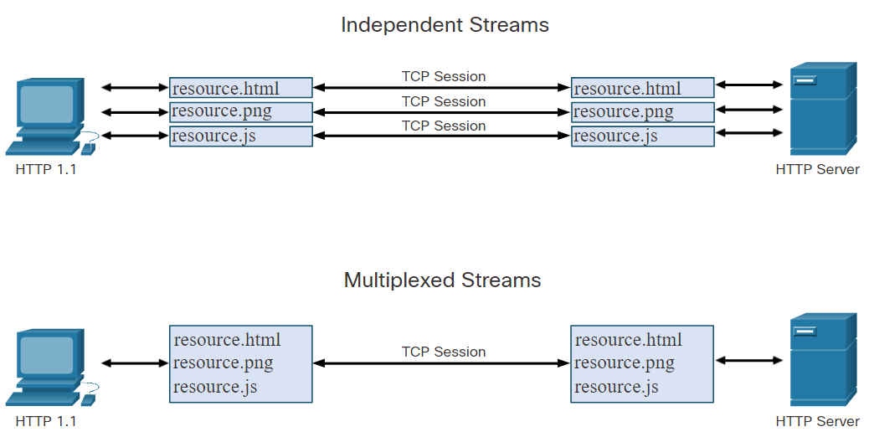
HTTP
HTTP/2
The purpose of HTTP/2 is to improve HTTP performance by addressing latency issues that existed in the HTTP 1.1 version of the protocol.
HTTP/2 uses the same header format as HTTP 1.1 and uses the same status codes.
Few important features of HTTP/2 that a cybersecurity analyst must be aware of:
Multiplexing
Server PUSH
A binary protocol
Header compression
Notes:
10– Network Services
10.6 - HTTP
10.6.5 – HTTP/2

Slide 51
HTTP
Securing HTTP – HTTPS
For secure communication across the internet, the HTTP Secure (HTTPS) protocol is used.
HTTPS uses authentication and encryption to secure data as it travels between the client and the server.
HTTPS uses the same client request-server response process as HTTP, but the data stream is encrypted with Secure Socket Layer (SSL), or Transport Layer Security (TLS), before being transported across the network.
HTTPS/2 is specified to use HTTPS over TLS with the Application-Layer Protocol Negotiation (ALPN) extension for TLS 1.2 or newer.
Confidential information is transmitted over the Internet using HTTPS.
Notes:
10– Network Services
10.6 - HTTP
10.6.6 – Securing HTTP – HTTPS

Slide 52
HTTP
Lab - Using Wireshark to Examine HTTP and HTTPS Traffic
In this lab, you will complete the following objectives:
Capture and view HTTP traffic
Capture and view HTTPS traffic
Notes:
10– Network Services
10.6 - HTTP
10.6.7 – Lab - Using Wireshark to Examine HTTP and HTTPS Traffic

Slide 53
10.7 Network Services Summary
Notes:
Source:
10 – Network Services
10.7 - Network Services Summary
In-Session Activities / Explanations:
Time: 7 min
Instructor Notes:
Read out the summary points mentioned on the slide.
Discuss the same with the participants.
Ask if they have any questions or doubts.
Ensure that the learners complete the module quiz.
Key Points: NA

Slide 54
Network Services Summary What Did I Learn in this Module?
Dynamic Host Configuration Protocol (DHCP) for IPv4 automates the assignment of IPv4 addresses. This is referred to as dynamic addressing and is the alternative to static addressing.
DHCP operation includes: DHCPDISCOVER, DHCPOFFER, DHCPREQUEST, DHCPACK, and DHCPNAK.
DNS resolves names to IP addresses. There are five steps involved in DNS resolution.
NAT provides the translation of private addresses to public addresses. A NAT router typically operates at the border of a stub network.
Port Address Translation (PAT), also known as NAT overload, maps multiple private IPv4 addresses to a single public IPv4 address or a few addresses.
FTP was developed to allow for file transfers between a client and a server. Trivial File Transfer Protocol (TFTP) is a simplified file transfer protocol that uses UDP port number 69.
Notes:
10 – Network Services
10.7 –Network Services Summary
10.7.1 - What did I learn In this Module?

Slide 55
Network Services Summary What Did I Learn in this Module? (Contd.)
Email clients communicate with mail servers to send and receive email.
Email supports three separate protocols for operation: SMTP, POP, and IMAP.
Web browsers and web servers interact using the four steps.
HTTP is a request/response protocol that uses TCP port 80.
When a client sends a request to a web server, it will use one of six methods that are specified by the HTTP protocol: GET, POST, PUT, DELETE, OPTIONS, and CONNECT.
HTTP status codes: 1xx, 2xx, 3xx, 4xx, and 5xx.
For secure communication across the internet, HTTP Secure (HTTPS) is used.
HTTPS uses authentication and encryption to secure data as it travels between the client and the server.
Notes:
10 – Network Services
10.7 –Network Services Summary
10.7.1 - What did I learn In this Module?
10.7.2 - Module 10: Network Services Quiz

Slide 56
Module 10 New Terms and Commands
DHCP(Dynamic Host Configuration protocol) Pool Lease period DNS (Domain Name System) DDNS (Dynamic DNS) WHOIS | FQDN ICANN RIPE APNIC NAT FTP TFTP | TCP UDP SMB SMTP POP IMAP
Notes:
10 – Network Services
New Terms and Commands

